Slide 1
Movie
Recommendation

Slide 2
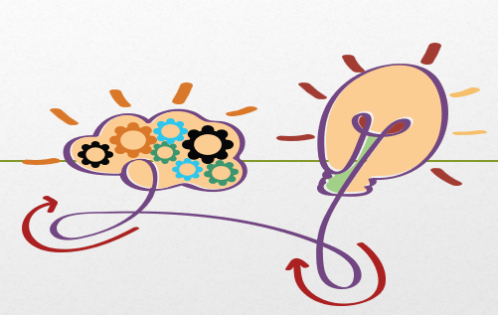
Problem and solution
Problem
Solution
Problem- people wasting a lot of time trying to search for movies of the same genre or have similar plot
Introducing the recommendation system that will help people finding movies of similar genre by entering the movie name

Slide 3
Types of recommendation system
Collaborative Filtering
Content based filtering
Hybrid approach

Slide 4
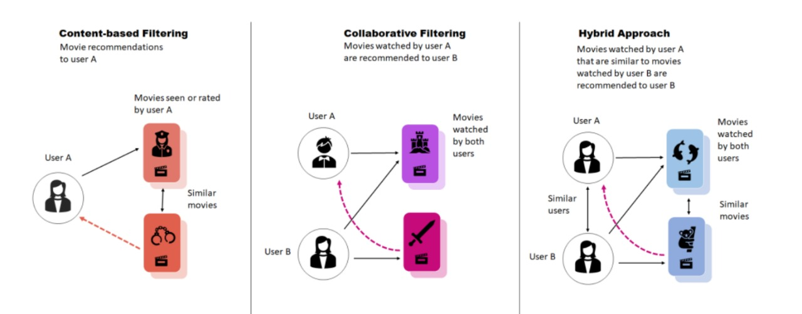

Slide 5
Content based Filtering
Recommend item similar to those a user
Has liked in the past
Document
collection
recommender
Web page
interaction
User Profile
User
feedback

Slide 6
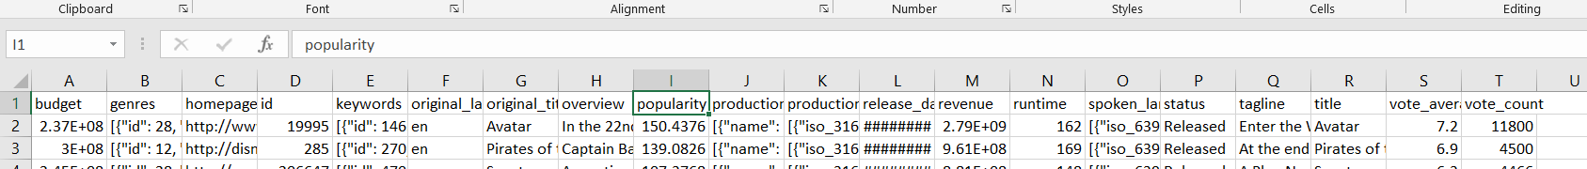
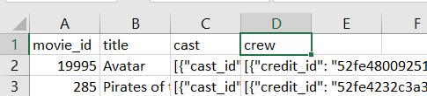
Data before cleaning

Slide 7
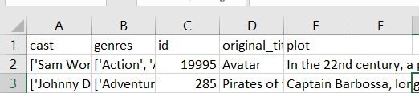
Data after cleaning

Slide 8
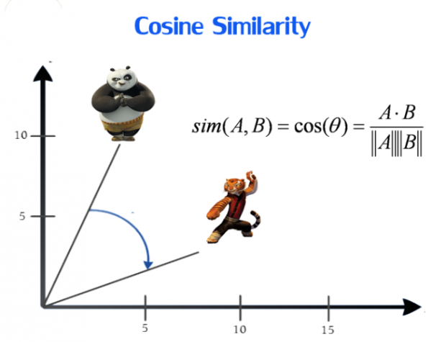
Cosine Similarity
Is a measure of similarity between two sequences of numbers .
And it used to measure the similarity between the movie entered by user and movies in the data

Slide 9
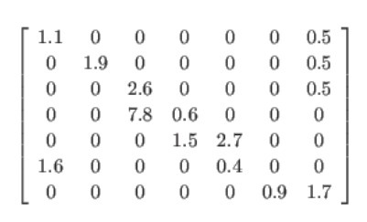
Sparse matrix
Steps of text document:
STEP 1 — Indexing
STEP 2 — Vector representation of the document
STEP 3 — Creating sparse vector for each document
CSR matrix representation requires three arrays:
Index — [0, 1, 0, 1, 2, 3, 4, 5, 3, 4, 6, 7]
Val- [ 1, 1, 1, 1, 1, 1, 1, 1, 2, 1, 2, 1]
Ptr- [0, 2, 8, 12]

Slide 10
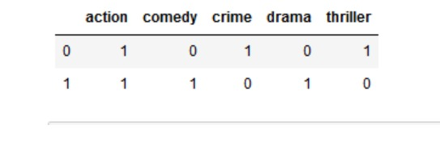
Bags of words
[‘action’, ‘comedy’, ‘crime’, ‘drama’, ‘thriller’]
Then we get a matrix of size 2 X 5, where D=2, N=5
The matrix M of size 2 X 5 will be represented as:

Slide 11
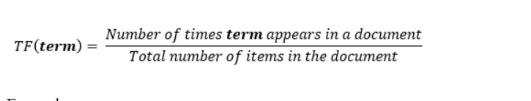
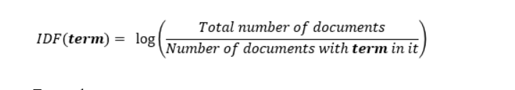
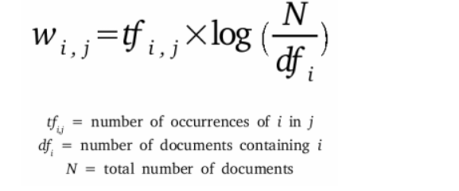
TF-IDF Vectorizer

Slide 12
Streamlit
-API
-Flask
Is an open source app framework in python language. It helps us create beautiful web-apps for data science and machine learning in a little time. It is compatible with major python libraries such as scikit-learn, keras, pytorch, latex, numpy, pandas and matplotlib

Slide 13


Slide 14
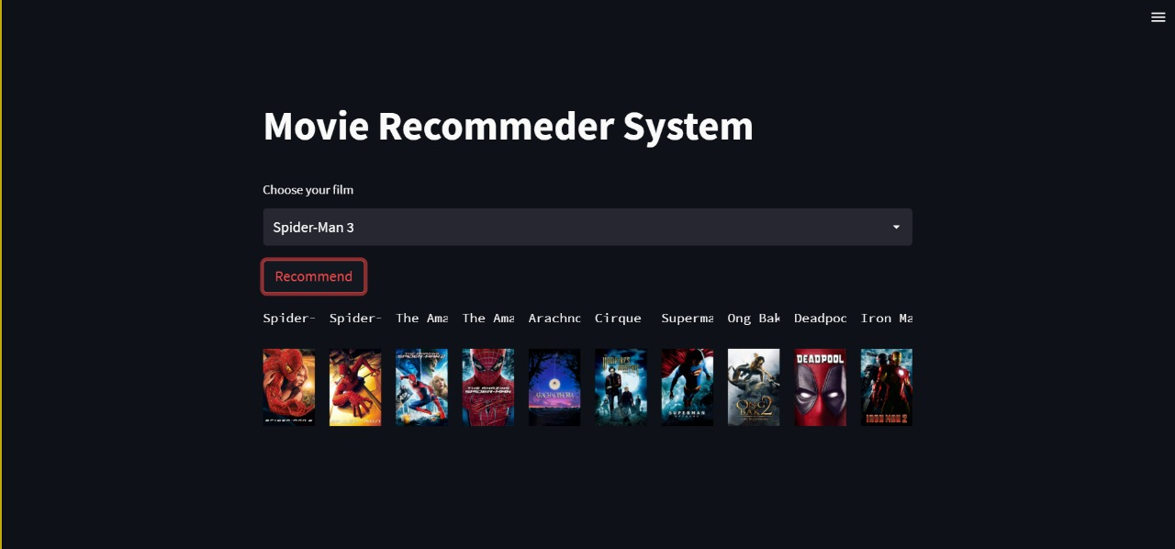

Slide 15
Questions

Slide 16
Thank you

